Slide 1

SALES DATASET ANALYSIS – (ADVANCED EXCEL AND ADVANCED SQL PROJECT)
BY :
DONA MERLIN M

Slide 2
Project Overview & Objectives
Objective:
Analyze Super Store sales data to uncover trends and patterns.
Tools Used:
Excel for data cleaning, visualization, and dashboard creation
SQL for querying and aggregating sales data
Dataset:
Super_Store.csv with ~9,994 records across orders, products, customers, regions, and sales

Slide 3
Data Cleaning
Data Cleaning Process
Duplicates were identified and removed to ensure data consistency.
Standardized formatting applied to the entire dataset:
Proper Date formats (e.g., DD-MM-YYYY for Order Date and Ship Date).
Corrected erroneous sales entries and flagged negative values using conditional formulas (e.g., IFERROR).

Slide 4
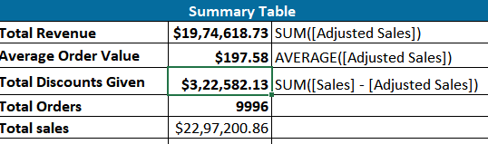
Key Metrics Calculation and Data Analysis
Important Calculations:
1. Total sales :
$1974618.73
2. Average sales per order
$197.58
3. Discount rates:
$322582.13
Screenshot:

Slide 5
SQL Analysis Highlights
Total Adjusted Sales: Aggregate revenue from all orders
Average Order Value: Order-wise spend by customers
Total Discount Given: Overall discount offered
Order Count: Unique orders placed
Key Queries:
Sales by Category, Segment, Region
Sub-Category performance with Quantity
Profitability analysis

Slide 6
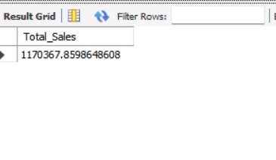
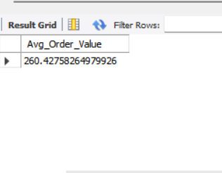
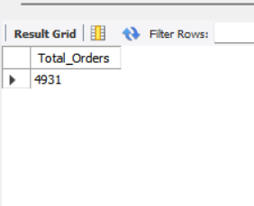
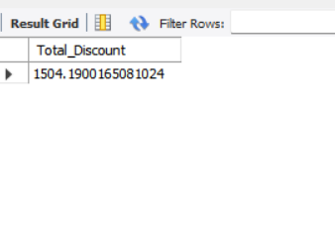
Screenshot

Slide 7
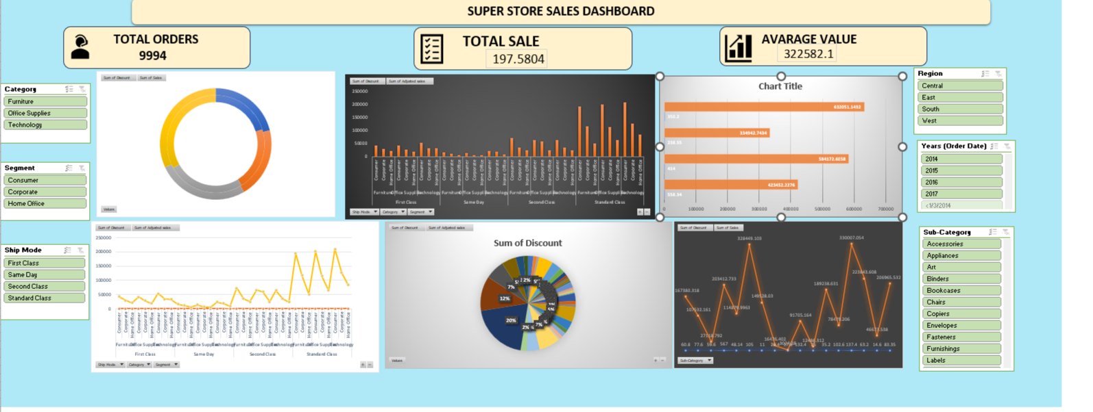
Dashboard

Slide 8
Insights and Recommendations
INSIGHTS:
Shipping Mode Trends:
Standard Class accounts for 59% of total adjusted sales — it's the dominant and most preferred mode.
Same Day shipping has low adoption (6%) and may not justify broad usage.
Product Category Performance:
Technology drives the highest revenue with fewer units — indicating high-value items.
Office Supplies has the highest volume but lower per-unit value.
Furniture underperforms in both sales and quantity.
Discount Impact:
Furniture suffers the most from discounts (16.65% loss).
Technology and Office Supplies show better control of discounting, especially Office Supplies (only 10.62% discount impact).

Slide 9
Insights and Recommendations
RECOMMENDATIONS:
Shipping Optimization:
Focus campaigns and bulk orders on Standard Class.
Limit Same Day to premium products or metro areas.
Encourage First/Second Class with promotional discounts.
Sales Strategy:
Highlight high-margin Technology items with targeted promotions.
Launch bundles/subscription plans for Office Supplies to increase value.
Rebrand and promote Furniture through seasonal campaigns or discounts.
Discount Strategy:
Apply data-driven discounting — avoid excessive offers on strong products.
Reduce high discount losses in Furniture with controlled offers.
Maintain modest, effective discounts in Office Supplies.
Return Management:
Improve product details, delivery care, and packaging — especially for large items — to reduce returns.

Slide 10
Thank you

